Slide 1
Vehicle Maintenance
PayneWest Insurance
Loss Control
Presentation by: Brendan Riley

Slide 2
RESOURCES

Slide 3
RESOURCES

Slide 4
RESOURCES

Slide 5
RESOURCES

Slide 6
RESOURCES
Loss control

Slide 7
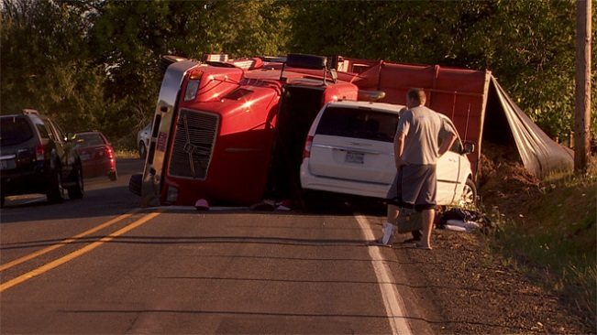
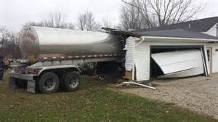
STATISTICS
2012 LARGE TRUCK AND BUS RELATED FATALITIES
4397
2013 LARGE TRUCK AND BUS RELATED FATALITIES
4436
2014 LARGE TRUCK AND BUS RELATED FATALITIES
4278
Source: FMCSA

Slide 8
Vehicle Maintenance

Slide 9
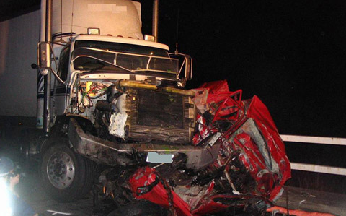
CONSEQUENSES
Failure to maintain brakes – resulting in fatal collision with car
Mechanic, owner and operator charged to vehicular homicide
More at stake here than DOT fines for non-compliance of the regulations
If your vehicle is involved in an accident and its found that your non-compliance was the cause, you will more than likely be criminally charged
If regulations were followed, the driver would still be alive today
FATAL ACCIDENT

Slide 10
VEHICLE MAINTENANCE
Inspect
Maintain
Repair
DOT Inspections
Pre-Trip
Annual Inspections
Post-Trip DVIR*
Inspection in Operation

Slide 11
VEHICLE MAINTENANCE
SYSTEMATICALLY
INSPECT
MAINTAIN
REPAIR
FMCSA Regulations Part 396

Slide 12
VEHICLE MAINTENANCE
SYSTEMATICALLY
Company Oversight
Scheduled Inspections
Preventative Maintenance
Driver Daily Inspections

Slide 13
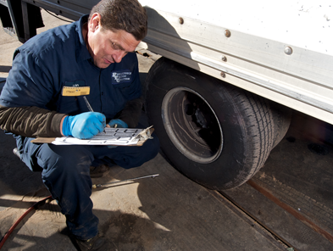
Driver Inspections
Pre Trip Inspection
Post Trip Inspection
Inspections While in Operation

Slide 14
Pre Trip Inspection
Service Brakes
Parking Brakes
Steering
Lighting/Reflectors
Horn
Windshield Wipers
Rearview Mirrors
Coupling Devices
Wheels & Rims
Emergency Supplies
Yesterday’s DVIR

Slide 15
Post Trip Inspection DVIR*
Service Brakes
Parking Brakes
Steering
Lighting/Reflectors
Horn
Windshield Wipers
Rearview Mirrors
Coupling Devices
Wheels & Rims
Emergency Supplies

Slide 16
DVIR*
End of each driver’s day
Each vehicle operated
Must note safety defects
Must have 3 signatures if safety defect if noted
Must be retained for 90 days
*No defect reporting

Slide 17
DVIR
X

Slide 18
Maintenance Program
Systematically Inspect, Maintain & Repair
Procedures in place for systematic inspection, maintenance & repair of all vehicles.
Maintain accurate records of all inspections, maintenance & repair

Slide 19
Inspector Qualifications

Slide 20
Brake Inspector Qualifications

Slide 21
Vehicle Service Due Status

Slide 22
Maintenance Record

Slide 23
Annual Inspection

Slide 24
Systematically Inspect Maintain & Repair
Schedule of inspections to be performed include type and due date.
Inspection, repair and maintenance records.
Vehicle
Maintenance

Slide 25
Systematically Inspect Maintain & Repair
Vehicle Maintenance File
Identifying Information
Company Number
Make
Serial Number
Year and tire size
Vehicle
Maintenance

Slide 26
Systematically Inspect Maintain & Repair
Roadside Inspection Reports
Certify within 15 days
Retain for 12 months
Vehicle
Maintenance

Slide 27
Systematically Inspect Maintain & Repair
Annual Inspections
Qualified Inspector
12 months
Minimum Periodic Inspection Standards – Appendix G
Vehicle
Maintenance

Slide 28
COMMON MISTAKES
No maintenance, inspection and repair schedule
Not inspecting mechanic file
Not inspecting DVIR’s to ensure compliance
No tracking system for annual inspections

Slide 29
THANK YOU!
Loss control

